Slide 1
PROTOCOLS
The protocols is a set of rules, that defines how communication between devices and systems are done which includes bit ordering, bit pattern meanings, data frames, error checking, etc,.
Widely used protocols in Embedded system
UART
SPI
I2C
USB
ETHERNET

Slide 2
INTER INTEGRATED CIRCUIT PROTOCOL (I2C or TWI )

Slide 3
History
Before 1980’s in Tv Sets- Microcontroller connected to each peripheral by wire
Complex and Bulky Structure
Philips Developed Two wired Protocol-I2C in 1982
Reduced Complexity

Slide 4
Basic Characteristics
Two wired bus
Speed
Normal mode - 100kbps
Fast mode - 400kbps
High Speed mode - 3.4mbps
Data Transfer - Serial, 8 bit oriented and bidirectional
Master slave approach with multi master option
Addressing - 7 bit or 10 bit unique addressing.

Slide 5
Overview
SCL : Serial Clock Line
SDA : Serial Data Line
Data transfer between devices connected to the bus
Master Slave Approach

Slide 6
Terms and Meanings
Transmitter
The device sending data to the bus
Receiver
Device receiving data from the bus
Master
Device initiating a transfer, generates to clock and terminates a transfer
Slave
Device addressed by the master

Slide 7
Multi-master
More than one master can attempt to control the bus
Arbitration
Two masters initiate I2C command at the same time, the arbitration procedure determines which master wins and can continue with the command.
Synchronization
procedure to sync then clocks of two or more devices

Slide 8
Master and Slave
Master
Controls the SCL
Starts and stops data transfer
Controls addressing of other devices
Slave
Device address by master

Slide 9
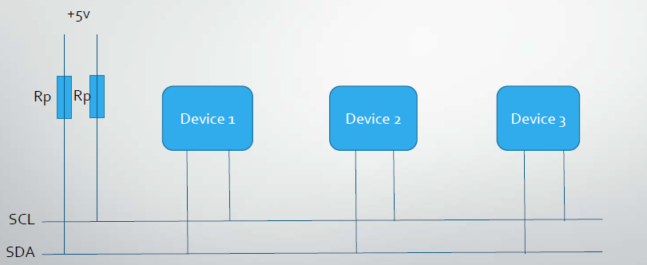
Physical Structure

Slide 10
Signal components
I2C Data transfer consist of 5 signal components
Start
Stop
Repeated Start
Data
Acknowledge

Slide 11
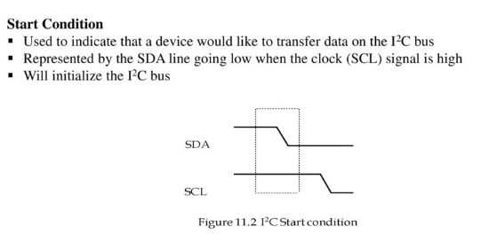

Slide 12
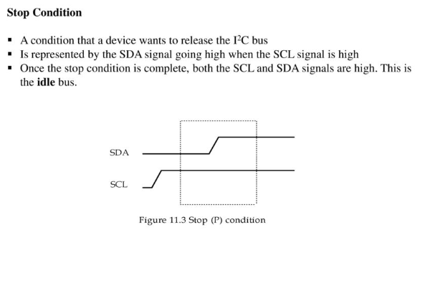

Slide 13
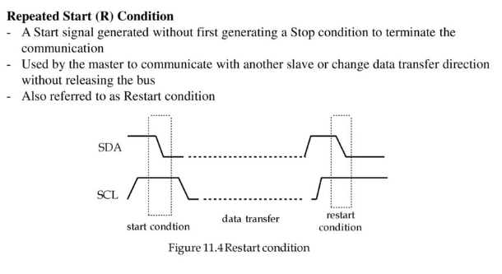

Slide 14
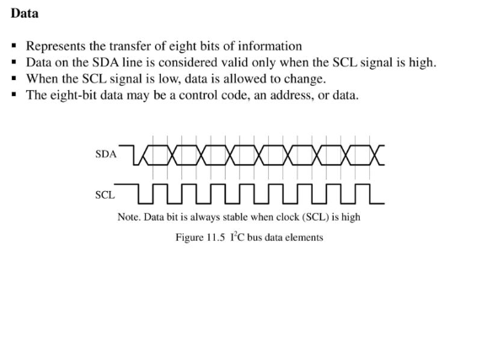

Slide 15
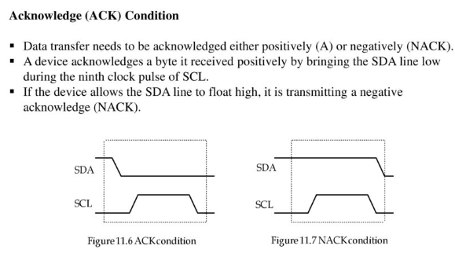

Slide 16
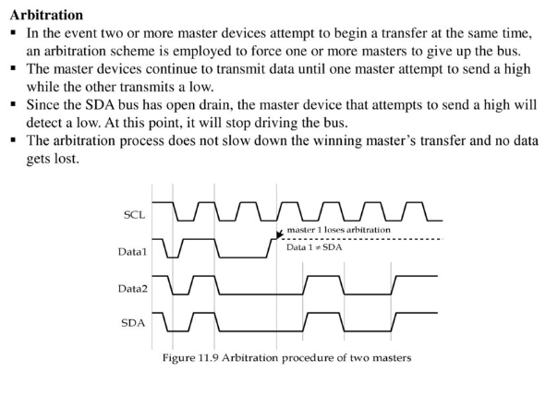

Slide 17
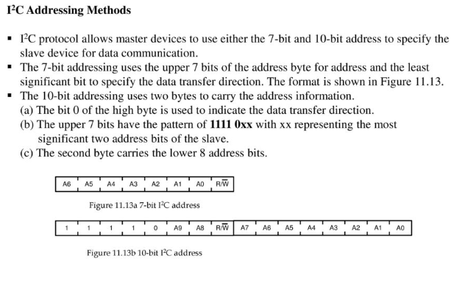

Slide 18
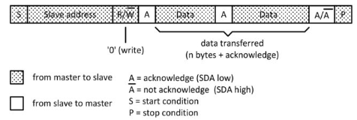
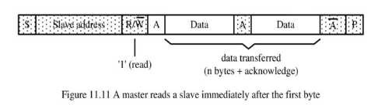
DATA Transfer format

Slide 19
SERIAL PERIPHERAL INTERFACE
(SPI)

Slide 20
Introduction
Communication Protocol Developed By Motorola
Four Wire Protocol
Serial Interface
Master-Slave Approach
Synchronous- Data clocked with Clock Signal
Data Rate-10mbps
Full duplex mode

Slide 21
Overview
Simple SPI Protocol Specifies 4 Signal Wires
1. Master Out Slave In (MOSI)
2. Master In Slave Out (MISO)
3. Serial Clock (SCLK)
4. Slave Select (SS)

Slide 22
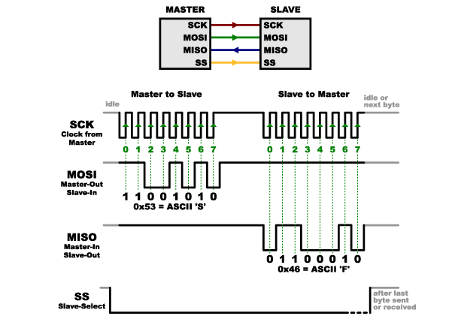
SPI COMMUNICATION

Slide 23
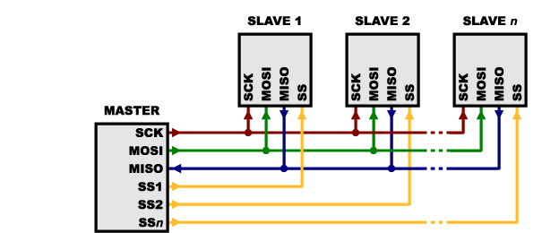
Multi slaves

Slide 24
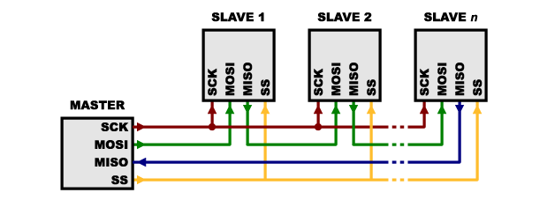
SPI daisy-chain

Slide 25
SPI Peripherals
Converters (ADC, DAC)
Memories (EEPROM, RAM’s, Flash)
Sensors (Temperature, Humidity, Pressure)
Real Time Clocks
LCD controllers, UART’s, USB controller, CAN controller, amplifiers

